Slide 1
Data Structures and Algorithms IICT-6005

Slide 2
Lesson Content
What is an Abstract Data Type?
Creating Abstract Data Types
Creating the Vector ADT
Operations on the Vector ADT
Using the Vector ADT
Creating an Array Based Vector Data Structure based on Vector ADT
Defining the Vector ADT operations for an Array Based Vector
Other implementations of the Vector ADT

Slide 3
Abstract Data Type
“An abstract data type (ADT) is a model for data types where a data type is defined by its behavior from the point of view of the data user.”
The implementation details for these behaviors are not defined (hidden); this allows us to replace one implementation with another to optimize efficiency, performance, etc. depending on the situation without interfering with the main program logic.
This contrasts to data structures, which are concrete representations of data, from the point of view of an implementer.
The implementation details for the Abstract Data Type need to be specified in the data structure.

Slide 4
Abstract Data Type
Creating an Abstract Data Type
Create an Interface for the Abstract Data Type
Create the Method Signatures defining the behaviors to be carried out by the Abstract Data Type
Using the Abstract Data Type
Create a Class for the Data Structure
Get the Class to implement the interface for the ADT
Define the programming logic for each behavior – this will be specific to the data structure being created

Slide 5
Creating the Vector ADT
A Vector ADT is a data type that stores an ordered sequence of elements.
In this example, a Vector ADT could be used to store an ordered sequence of employees, where each employee has a name and a salary.
Being an abstract data type, the concrete implementation is not important at this time.
Name of Employee
Susan Williams
Mathew Jones
Annie Bartlett
Martin Wallis
David Carter

Slide 6
Creating the Vector ADT
The rank of an element indicates its position within the Vector ADT.
The rank of an element is defined as the number of items before it within the Vector ADT.
The first element has rank 0
The last element has rank n-1, where n is the number of elements in the Vector ADT.
Rank | Name of Employee
0 | Susan Williams
1 | Mathew Jones
2 | Annie Bartlett
3 | Martin Wallis
4 | David Carter

Slide 7
Operations on the Vector ADT
An operation is an action on an ADT, which may or may not change the data.
It is important that after each operation on an ADT, you end up with the same ADT (perhaps in a different state).
Rank | Name of Employee
0 | Susan Williams
1 | Mathew Jones
2 | Annie Bartlett
3 | Martin Wallis
4 | David Carter

Slide 8
Operations on the Vector ADT
Operations on the Vector ADT include:
Size( ) : int returns the number of elements in the Vector ADT.
IsEmpty( ) : bool returns true when Size( ) is 0 returns false otherwise
In this example : Size( ) = 5 IsEmpty( ) = false
Rank | Name of Employee
0 | Susan Williams
1 | Mathew Jones
2 | Annie Bartlett
3 | Martin Wallis
4 | David Carter

Slide 9
Operations on the Vector ADT
Operations on the Vector ADT include:
ElementAtRank(r : int) : object returns the element found at rank r in the Vector.
In this example:
ElementAtRank( 1 ) will return Mathew Jones.
So far, none of these operations changed the Vector’s state.
Rank | Name of Employee
0 | Susan Williams
1 | Mathew Jones
2 | Annie Bartlett
3 | Martin Wallis
4 | David Carter

Slide 10
Operations on the Vector ADT
Operations on the Vector ADT include:
ReplaceAtRank(r : int, o : object) : object replaces the element found at rank r of the Vector with object o and returns the old element
In this example: ReplaceAtRank(1, “Donna Sanchez”) Will replace the element at rank 1 and returns value “Mathew Jones”.
Rank | Name of Employee
0 | Susan Williams
1 | Donna Sanchez
2 | Annie Bartlett
3 | Martin Wallis
4 | David Carter
Mathew Jones

Slide 11
Operations on the Vector ADT
Operations on the Vector ADT include:
InsertAtRank(r : int, o : object) Inserts an element at rank r of the Vector and the elements from that position onwards one place backwards.
In this example:
InsertAtRank(1, “Lawrence Baker”) Will place “Lawrence Baker” at rank 1 and move the other elements one position backwards.
Rank | Name of Employee
0 | Susan Williams
1 | Lawrence Baker
2 | Donna Sanchez
3 | Annie Bartlett
4 | Martin Wallis
5 | David Carter

Slide 12
Operations on the Vector ADT
Operations on the Vector ADT include:
RemoveAtRank(r : int ) : object Removes an element at rank r of the Vector and returns that element. The elements behind it are moved one place forward to close the gaps.
In this example, RemoveAtRank(1)
Will return the element “Lawrence Baker”.
Rank | Name of Employee
0 | Susan Williams
1 | Lawrence Baker
1 | Donna Sanchez
2 | Annie Bartlett
3 | Martin Wallis
4 | David Carter

Slide 13
Operations on the Vector ADT
When executing the following operations:
ElementAtRank, RemoveAtRank, ReplaceAtRank,
it is important that 0 ≤ r ≤ Size( ) – 1
If the rank r falls outside the above range, then there is no element within the ordered sequence of elements with rank r.
In this case, an exceptional case occurs and an exception is thrown to indicate this.
When executingInsertAtRank operations,
it is important that 0 ≤ r ≤ Size( )
In the case when r = Size( ), the element is appended to the end of the ordered sequence of elements.

Slide 14
Using Vector ADT
To implement a Data Structure for the Vector ADT, a data type to store the ordered sequence of elements is required
Many programming languages offer the possibility to create an Array i.e. a fixed size, contiguous, ordered sequential sequence of items of the same type.
This would allow for the creation of an Array-Based Vector i.e. a data structure that implements the Vector ADT using arrays.
There are different types of arrays available in the .Net :
object[ ] T[ ] int[ ] String[ ]
The Vector ADT would allow us to apply the functions specified in the Abstract Data Type to any one of these arrays and implement them in the most efficient way possible for each data structure

Slide 15
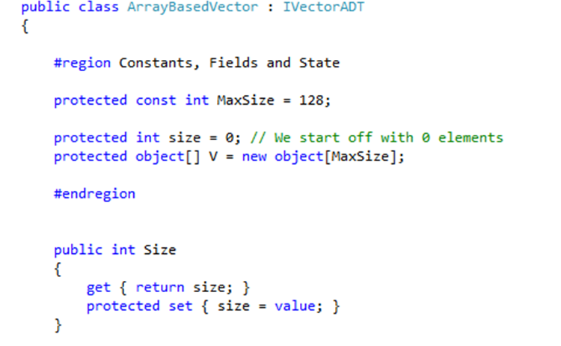
Creating Array Based Vector
Array Based Vector
The implementation of an Array Based Vector requires two variables:
V is an array of objects that stores the ordered sequence of elements.
Note :
V is created at a predetermined fixed size and all elements are initially empty.
Size is an integer that stores the number of elements currently in V.
size : int
0
V : object[ ]

Slide 16
Creating Array Based Vector
Initially size is 0, but the length of array V is larger than 0.
Simple Array Based Vectors are Non-Growable:
When V becomes full, an exception will be thrown and no further elements may be added.
However, it is possible to create a Growable Array Based Vector :
When V becomes full, it is possible to copy all the elements of V to a new, array, which is 1 element bigger than V, allowing for the new element to be added.

Slide 17
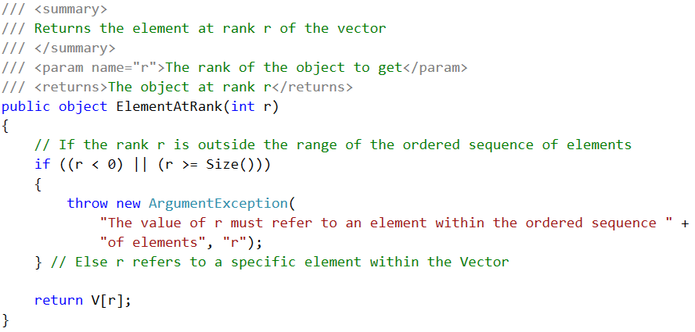
Defining the Implementation of Array Based Vector Operations

Slide 18
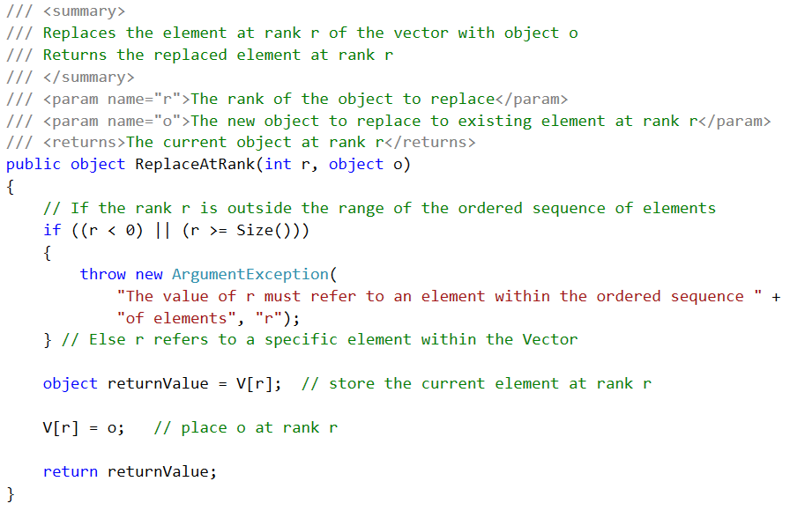
Defining the Implementation of Array Based Vector Operations

Slide 19
Defining the Implementation of Array Based Vector Operations
Array Based Vector
Insert At Rank involves :
Copying all existing elements from the specified rank onwards 1 position down
Overwriting the previous item in the specified rank with the new object
Example :
InsertAtRank(2, 9)
Initially, the Array Based Vector has 5 items.
The operation will insert value 9 at rank 2.
size : int
5
V : object[ ]
7 | 2 | 5 | 6 | 3
r

Slide 20
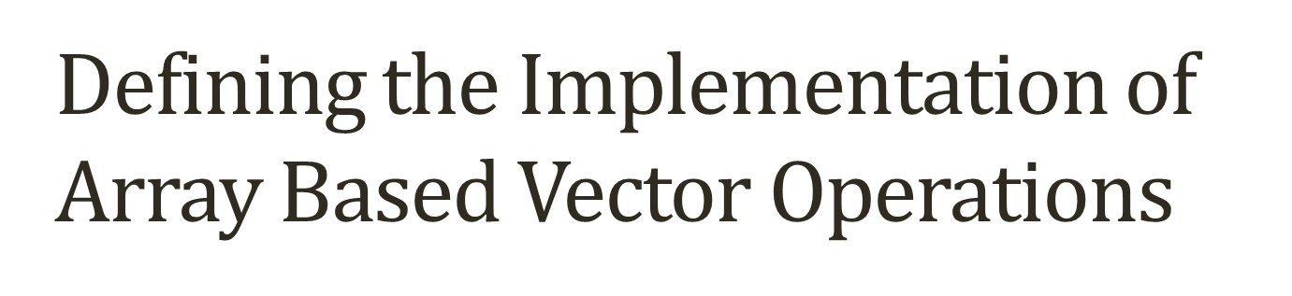

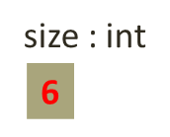
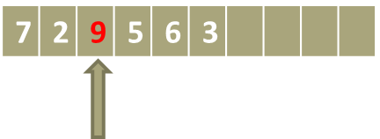

Array Based Vector
Starting from the end of the elements, copy the elements in the next location.
Notice that the value “5” in rank 2 has now been copied.
Rank 2 is “free” and we can place current value, which is now duplicate, with the new element.
size : int
5
V : object[ ]
7 | 2 | 5 | 5 | 6 | 3
r

Slide 21
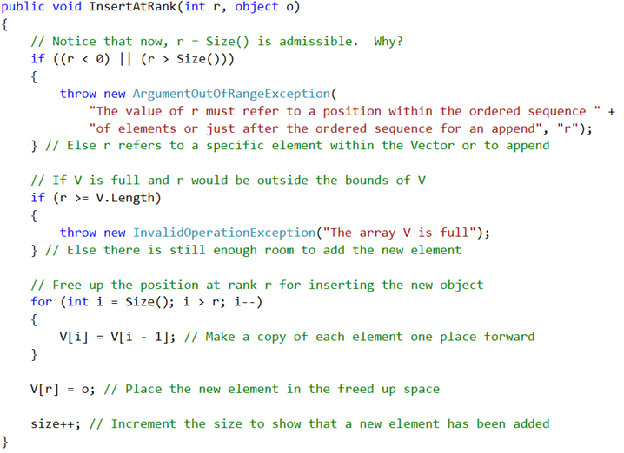

Slide 22
Other Implementations of Vector ADT
Besides the Array Based Vector, there are other different possible data structures that are able to implement the Vector ADT.
The implementation of methods for these would have been very different from the implementation for the Array Based Vector!
Example: Linked Lists
Implementation needs to take care to update pointers to next (and/or) previous element in the list correctly!
Also, Vectors can be used as part of the implementation of more complex data structures (such as trees).

Slide 23
Summary
What is an Abstract Data Type?
Creating Abstract Data Types
Creating the Vector ADT
Operations on the Vector ADT
Using the Vector ADT
Creating an Array Based Vector Data Structure based on Vector ADT
Defining the Vector ADT operations for an Array Based Vector
Other implementations of the Vector ADT

Slide 24
Exercises
For the given VectorADT and Array Based Vector Example implement:
public bool IsEmpty()
public object GetElementAtRank(int r)
public object ReplaceElementAtRank(int r, object o)
The given example for Array Based Vector implements a Non-Growable Array. Use the Vector ADT to create a Growable Array Based Vector
Create an ADT for operations carried out by a Stack; use the StackADT to implement an Array Based Stack.
Create an ADT for operations carried out by a Queue; use the StackADT to implement an Array Based Stack.

Slide 25
End of lesson
Any questions?

